Slide 1
Section 6.2
Permutations with Repeated Objects and Combinations

Slide 2
Suppose you have four cards: a king, a queen, a jack, and an ace. How many different permutations can you have?
Now suppose three cards were the same, ie: the queen is also an Ace. How would the number of permutations be affected?
Now suppose one of the cards was a duplicate, ie: the Jack is now an Ace. How would the number of permutations be affected?
Now suppose All four cards were the same, How would the number of permutations be affected?
Q K A A
A K Q J
A K A A
Q K J A
K A A A
A K Q A
K Q A A
J K Q A
K Q J A
A K J Q
A K A Q
J K A Q
Q K A J
K Q A J
A A A A
A J Q K
A A A K
K A A Q
A A Q K
J A Q K
Q A A K
K A J Q
Q A J K
A Q J K
A Q A K
Q J A K
J Q A K
K J A Q
A J K Q
Q A K A
A A K A
Q A K J
K A Q A
A A K Q
J A K Q
K A Q J
A J Q K
A Q K A
Q J K A
J Q K A
K J Q A
All the remaining permutations
will be the same: A A A A
All the queen’s are now aces, and every 3
remaining permutation will be a repeat
All the jack’s will be come aces and some permutations will be repeats
So the number of permutations with 3
repeats will be divided by another 3
So ,the number of remaining
permutations will be divided
by 4, leaving only one
permutation
Every 2 permutation will become one, so the number
of permutations will be divided by 2
© Copyright all rights reserved to Homework depot: www.BCMath.ca

Slide 3
If there were 4 objects and 2 of them
were the same, the number of
permutations will be:
If 3 of them were the same, the number
of permutations will be:
If 4 of them were the same, then number
of permutations will be:
Ex: We have two apples, 1 banana, 1 orange and 1 pear. How can we distribute it to 5 different people?
There are 5 fruits, so we have 5! on top
The apples are repeats, so we have 2! at the bottom
© Copyright all rights reserved to Homework depot: www.BCMath.ca

Slide 4
I) Permutations with Similar objects:
If there are “n” objects in total, and there are:
“a” similar objects from the first group,
“b” similar objects from the next group,
“c” similar objects from another group, and so on....
the total number of permutations will be:
Ex: Suppose there are 3 kings, 2 queen’s, 1 jack, and 4 aces. How many different ways can we arrange these 10 cards?
Total number of cards
Total number of permutations:
Number of kings
Number of queens
Number of jacks
Number of aces
© Copyright all rights reserved to Homework depot: www.BCMath.ca

Slide 5
EX: DETERMINE THE NUMBER OF PERMUTATIONS WITH ALL THE LETTERS IN EACH OF THE FOLLOWING WORDS.
BOOKKEEPER
BOOMSHAKALAKA
“P” and “R” each have only one, so
you can just neglect them
Total number of letters
Number of B’s
The number of permutations will be:
Number of O’s
Number of K’s
Number of E’s
Number of O’s
Number of A’s
Number of K’s
Neglect the letters with no repeats
© Copyright all rights reserved to Homework depot: www.BCMath.ca

Slide 6
Jack is travelling from home to work. Using the map provided, if jack can only travel east and south, how many different paths can he take?
East
Note: Jack can ONLY
Travel EAST & SOUTH
E
E
E
Each path is a different
Permutation of South & East
S
S
E E E S S S
E
South
S E S E E S
S
S
S S E E S E
The total number of permutations will be given by:
E
E
S
S
© Copyright all rights reserved to Homework depot: www.BCMath.ca

Slide 7
Practice: given each of the following grids, how many different paths are there from A to B if you can only travel right and down?
A
Any path from A to B will require 4 right
movements and 6 down movements
So the total number of different paths will be:
B
© Copyright all rights reserved to Homework depot: www.BCMath.ca

Slide 8
II) Combination as Repeated Objects
Ex: Suppose you have 6 swimmers and only 3 can advance to form a team. How many teams are possible?
In this scenario, the order of who advances first second or third does not matter.
When order doesn’t matter, we are looking for all the different combinations
One way to understand this is to find all the combinations with 3 ppl advancing
“Y” and 3 people NOT advancing “N”
YYYNNN
YNYNYN
NNNYYY
NYNYNY
YYNYNN
YNYNNY
NNYNYY
NYNYYN
YYNNYN
YNNYYN
NNYYNY
NYYNNY
YYNNNY
YNNYNY
NNYYYN
NYYNYN
YNYYNN
YNNNYY
NYNNYY
NYYYNN
There are 20 teams possible
© Copyright all rights reserved to Homework depot: www.BCMath.ca

Slide 9
III What is a Combination?
Combinations refers to the numbers of ways a group of objects can be arranged, such that the order is NOT important
If “order” is important, then we count using permutations or the FCP
If “order” is NOT important, then we count using combinations or permutations with repetitions
Ie: Suppose 3 people would be chosen from 5 to form a council. How many different groups of 3 can we create?
If we list out all the permutations, some groups are repeated because they
are combinations of the same members
ABC
ABD
ABE
ACD
ACE
ADE
BCD
BCE
BDE
CDE
ACB
ADB
AEB
ADC
AEC
AED
BDC
BEC
BED
CED
BAC
BAD
BAE
CAD
CAE
DAE
CBD
CBE
DBE
DCE
Since order is not important, every 6 permutation is the same as 1 combination.
So there are only 10 different combinations
BCA
BDA
BEA
CDA
CEA
DEA
CDB
CEB
DEB
DEC
CAB
DAB
EAB
DAC
EAC
EAD
DBC
EBC
EBD
ECD
CBA
DBA
EBA
DCA
ECA
EDA
DCB
ECB
EDB
EDC
Same combination!!
© Copyright all rights reserved to Homework depot: www.BCMath.ca

Slide 10
Formula for Combinations:
When there are “n” number of objects, with “r” number of objects to be chosen, the number of combinations will be:
“r” is the number of objects chosen &
“n – r” is the number of
objects NOT chosen
The combination formula is the same as the permutation formula divided by “r!”
© Copyright all rights reserved to Homework depot: www.BCMath.ca

Slide 11
Ex: Evaluate the following expressions:
Two ways to do this question
OR
OR
© Copyright all rights reserved to Homework depot: www.BCMath.ca

Slide 12
Practice: Solve for ‘N’
Note: There are 2 answers
“r” represents the number of spaces
2 methods to go from here: cross
multiply or use factors of 56
Since 56 = 8 * 7, assume n = 8
Therefore, r = 3 and 4
Both sides are equal, therefore
© Copyright all rights reserved to Homework depot: www.BCMath.ca

Slide 13
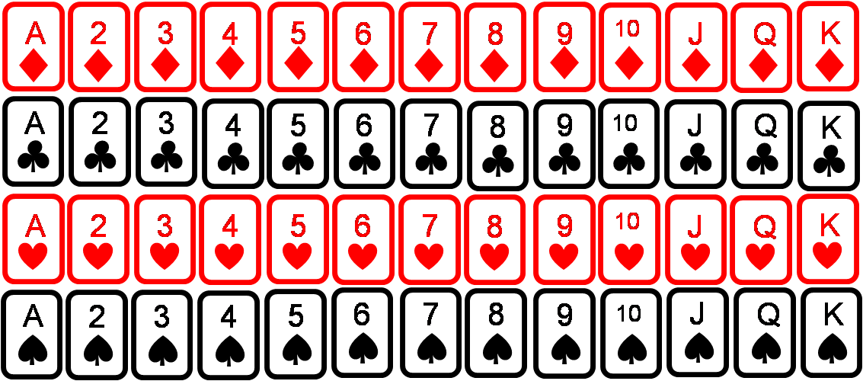
In a deck of cards, there are 52 cards, with 13 Spades, hearts, Clubs, and Diamonds. Find the number of combinations for each hand:
a) How many 5 card hands are possible
In a deck, there are 52 cards
There are 3 royal cards each
A
2
3
4
5
6
7
8
9
10
J
Q
K
b) How many 5 card hands with spades only?
A
2
3
4
5
6
7
8
9
10
J
Q
K
A
2
3
4
5
6
7
8
9
10
J
Q
K
c) A “flush” contains all 5 cards with the same suit. How many flush hands are there?
A
2
3
4
5
6
7
8
9
10
J
Q
K
Flush with Spades, Hearts, Clubs, and Diamonds
© Copyright all rights reserved to Homework depot: www.BCMath.ca

Slide 14
Ex: Using only the eight points around the circumference of a circle, how many different triangles can you make?
A
There are 8 points around the circle
H
B
Every triangle requires 3 points
So the number of triangles will be 8 Choose 3
G
C
F
D
E

Slide 15
Challenge: There are 6 teams in a tournament & each team must play 2 other teams. How many schedules are possible?
A
There are 6 teams, so draw a circle with 6 pts
Each line represents a game between 2 teams
H
B
If you make a triangle, then these three teams
play against each other
So the games are: AH, AB, BH
This is one schedule
F
D
FD, DE, EF
So, how many other schedules are possible?
E

